Slide 1


Royal University of Phnom Penh
Faculty of Engineering
Ebox Inventory System
Department : Information Technology Engineering
Course : Web Cloud Technology
Year 3, Semester 2
Team
-Huot Lysokheng
-Mekmun Sopheaktra
-Tan Sophea

Slide 2
Table of Content
01.
02.
03.
General Introduction
Problem Statement
Project Vision
04.
05.
Project Scope
Conclusion

Slide 3
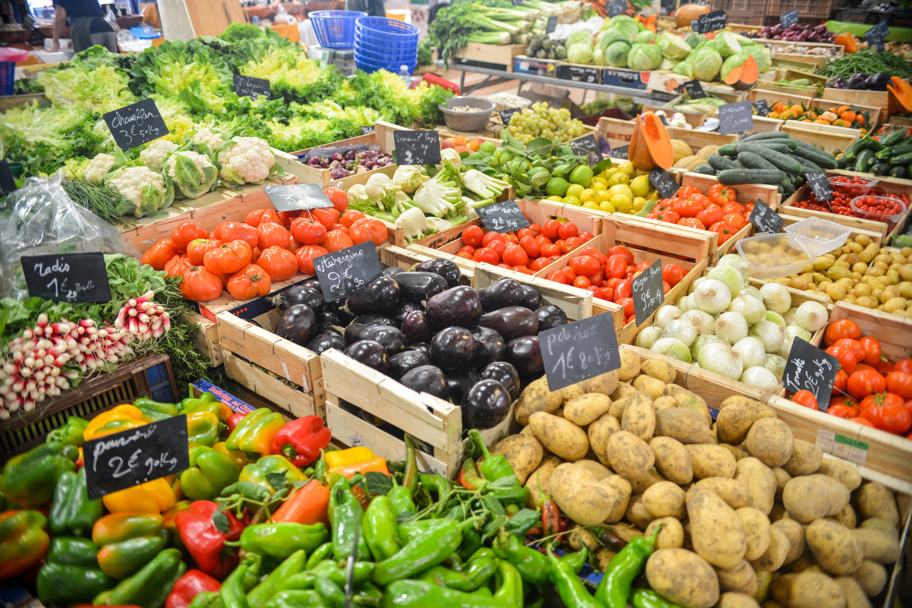
01.General Introduction
Script : នៅក្នុង Grocery Store មួយតែងតែមាន ឥវ៉ាន់ច្រើនដើម្បីគ្រប់គ្រង នៃលំហូរការលក់ចេញ ទិញចូល ស្តុកទុក ជាដើម។ ដើម្បីឲ្យងាយស្រួលក្នុងការរៀបចំទំនិញទាំងនោះជាទូទៅ អ្នកត្រួតពិនិត្យត្រូវកត់ត្រាទិន្នន័យនោះទុក។
Grocery Store​​ Inventory
In a Grocery Store, there is always a lot of luggage to control the flow of sales, purchases, stockings and so on. To make it easier to organize the goods, the inspector usually records the data.

Slide 4
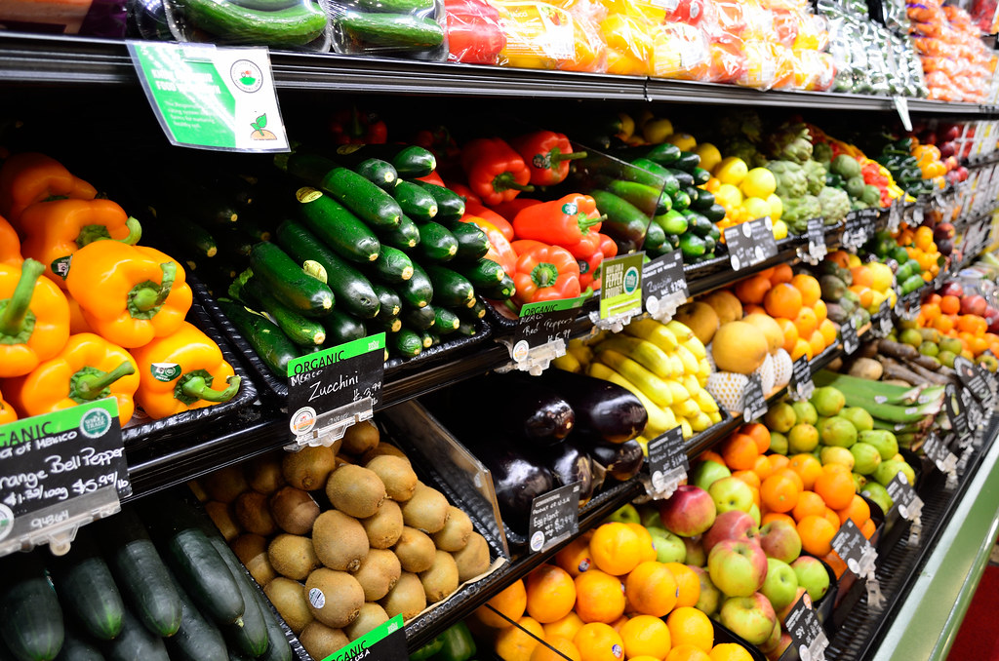
02.Problem Statement
1
2
Ebox Inventory System
Manage your Grocery store
Inventory Record and Tracking
Find Information of Products
The grocery store has a lot of products category that make recording and tracking of products difficult to manage in-store sales data.
All in-store purchases. Buyers are likely want to know about some product details before they choose it . Example: product come from, price, quantity and expiration date.

Slide 5
Project Vision
Ebox Inventory System
Is a website created to manage inventory in store. Details of the goods are recorded and will be available to buyers for viewing.
Manage Inventory Record
Find​ Or View Information of Products
Imported, exported, and stock​ management. Tracking and summary data about products in inventory.
Produce QR Code that customer can scan to see about Products information and details.

Slide 6

Our Services
Project Scope
Create Inventory Record
Grocery Owner Authentication
List all products in store and divide products into category.
Inventory System have endpoint for Grocery owner to access and manage.
Store​ Product Quantity and History
Produce QR Code Products information
Store products exports, imports, and in stock of all products and view history.
System can generate QR Code and store products details for ready to scan.
Create Products Information
Customer scan QR Code to view Products Information
Create products details of products, and more.
Customers can scan QR Sticker in every products to view details.

Slide 7
Inventory System Technology
#1 Front End
Flutter Web
GetX ( State Management )
Technology will use in inventory system.
Website based
#2 Back End
System create for grocery inventory management and help owner for manage products and customer easy to find information.
Laravel
Docker
#3 Hosting
Netlify
AWS

Slide 8
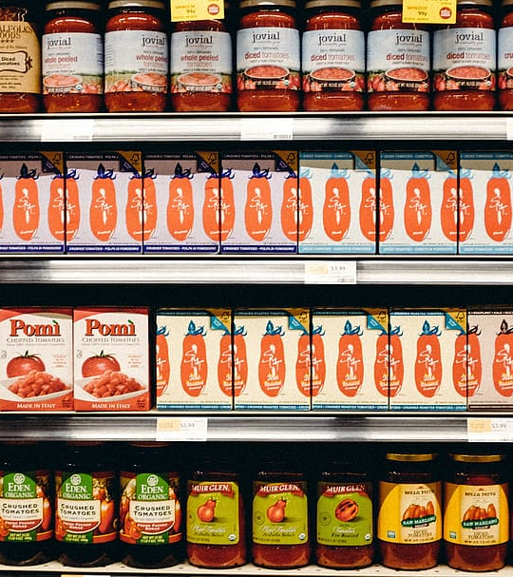
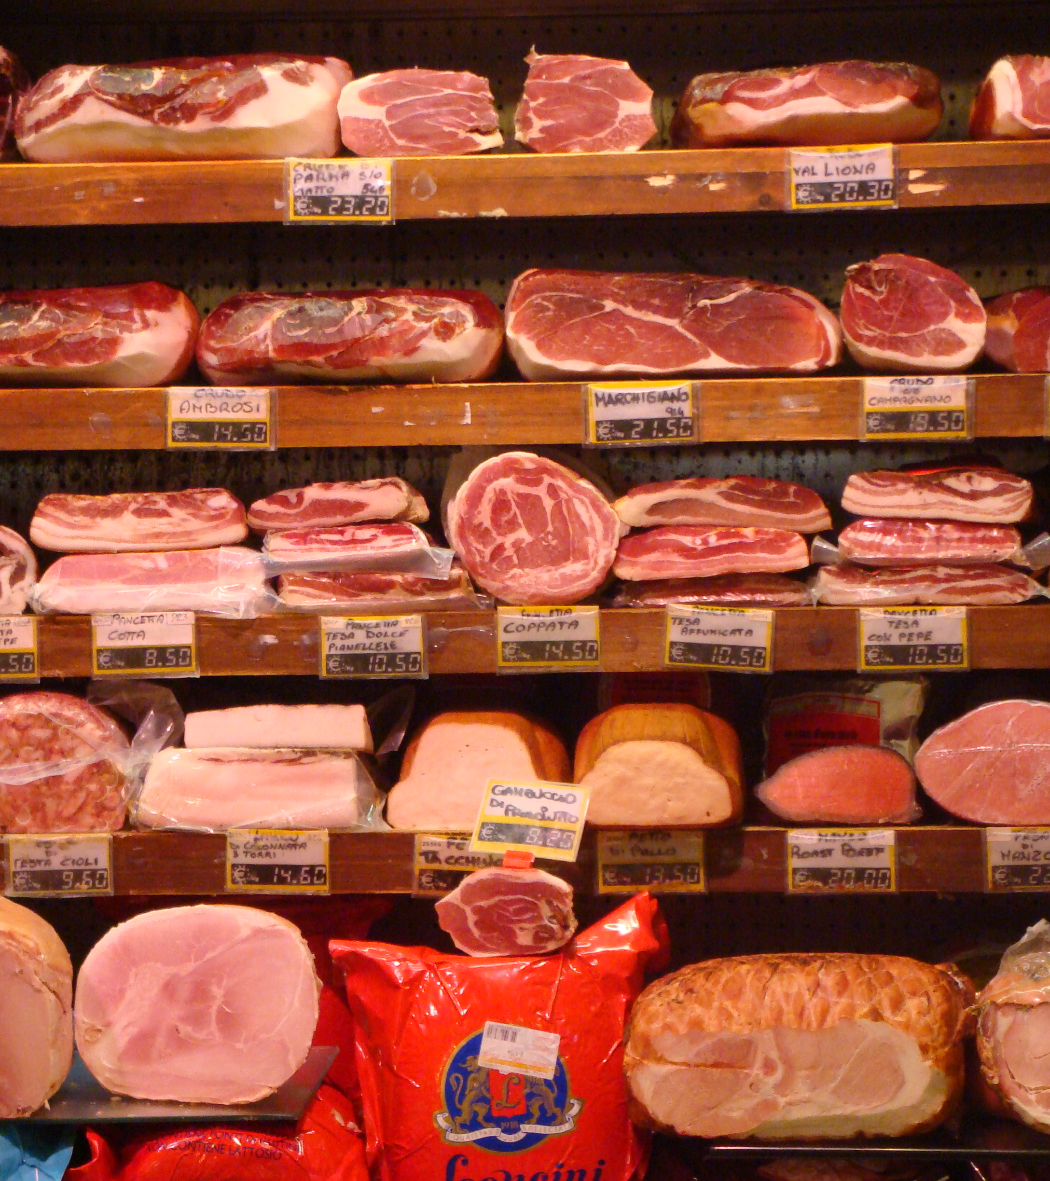
Conclusion
Etiam venenatis in odio vel mattis.Cras quis dui nulla. In eu orci at nulla commodo tempor non non tortor Nam diam mi, dictum vitae eros vitae, imperdiet
This Photo by Unknown Author is licensed under CC BY-SA

Slide 9

Ebox Inventory System
Thanks For Watching

